Slide 1

DEV

Slide 2

TEST

Slide 3








Slide 4
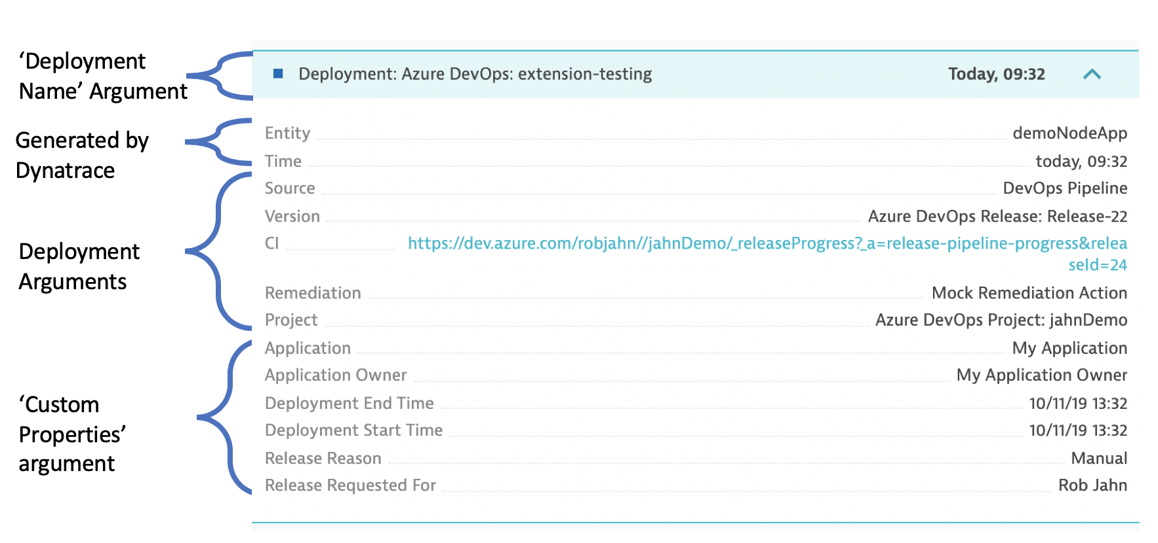
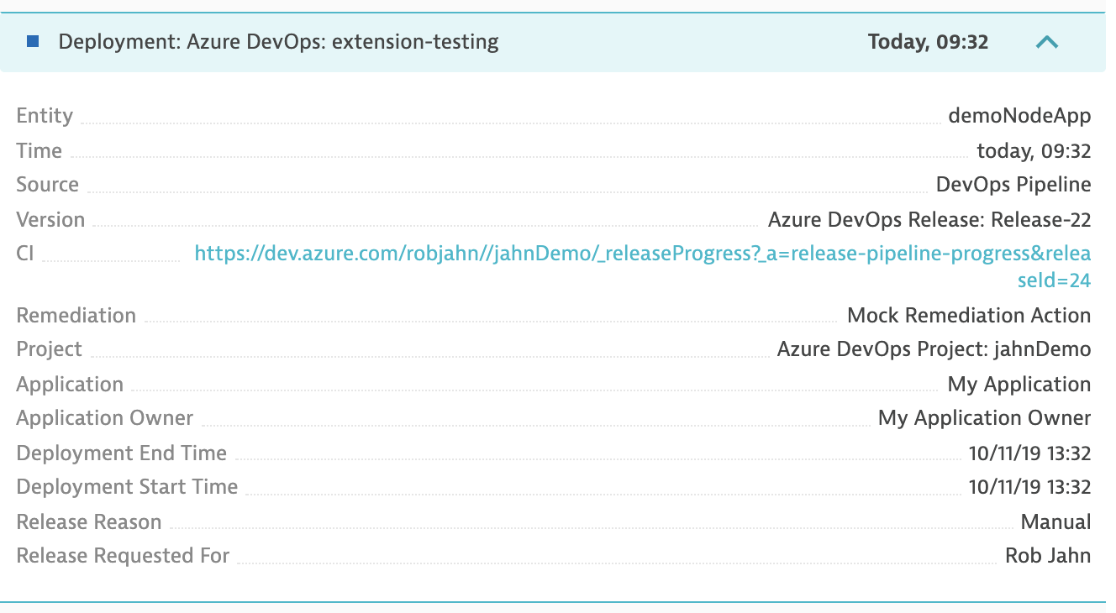
‘Deployment Name’ Argument
Generated by Dynatrace
Deployment Arguments
‘Custom Properties’ argument

Slide 5

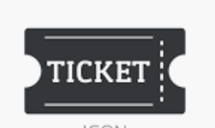








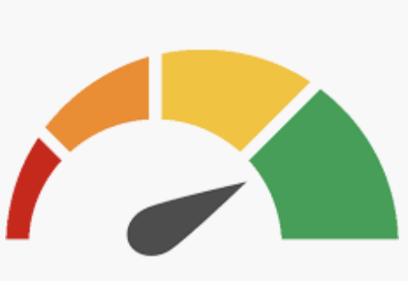











ACM ICON SET
DYNATRACE CONFIGURATION
DYNATRACE PUSH EVENT
TICKETING
QUALITY GATE
CONFIGURATION
PERFORMANCE TEST
ADD SYNTHETIC MONITOR
FUNCTIONAL TEST
SECURITY TEST
SEND PROBLEM
https://www.123rf.com/clipart-vector/test.html?alttext=1&sti=nv0zp97eec4sfvt3ah|&mediapopup=40290560

Slide 6












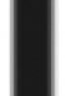






Slide 7


Slide 8
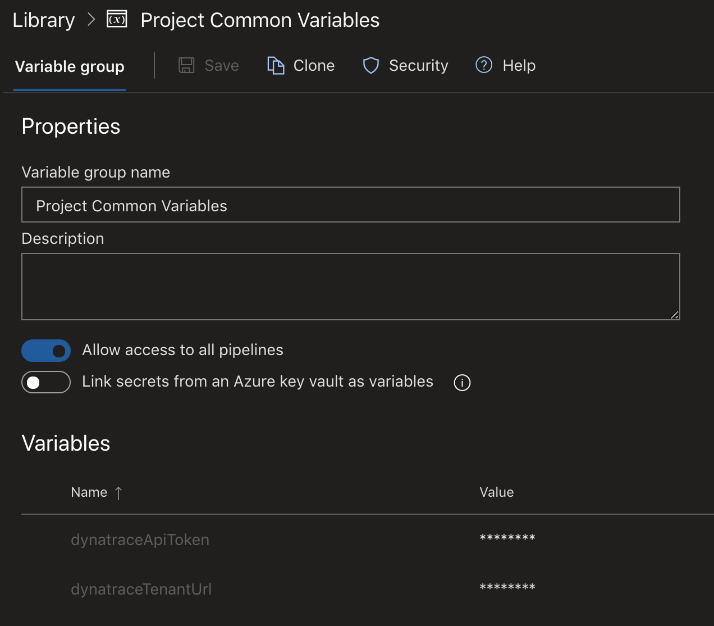

Slide 9
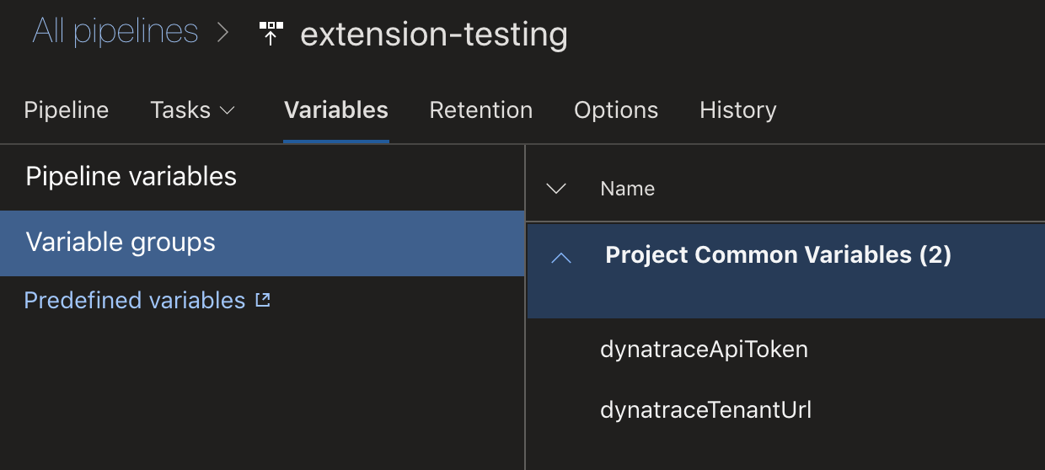

Slide 10
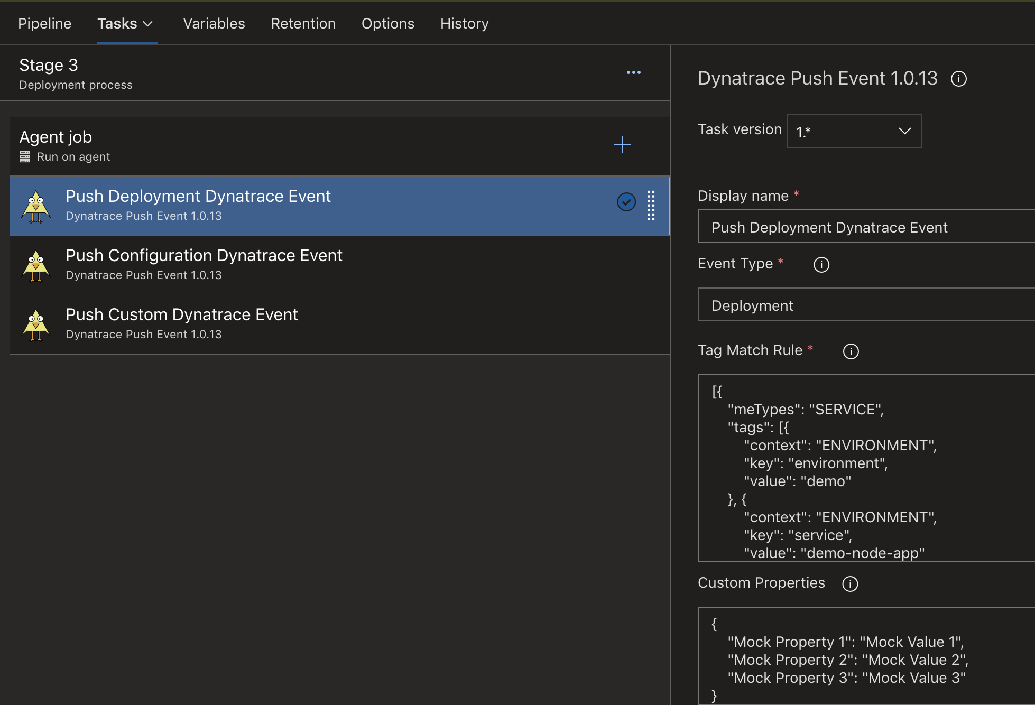

Slide 11
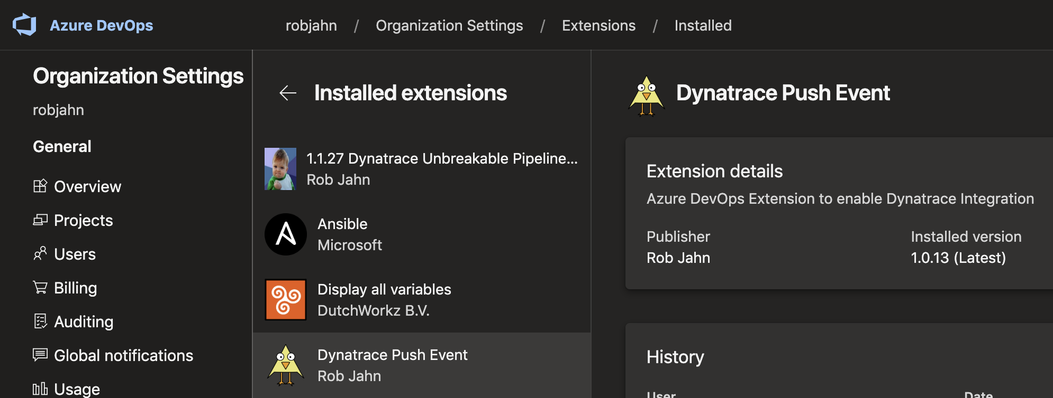
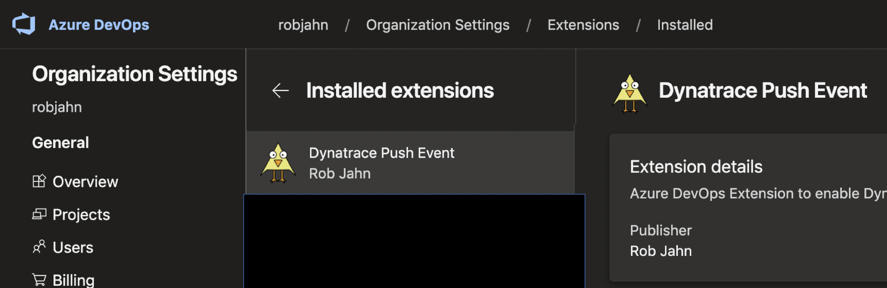


Slide 12
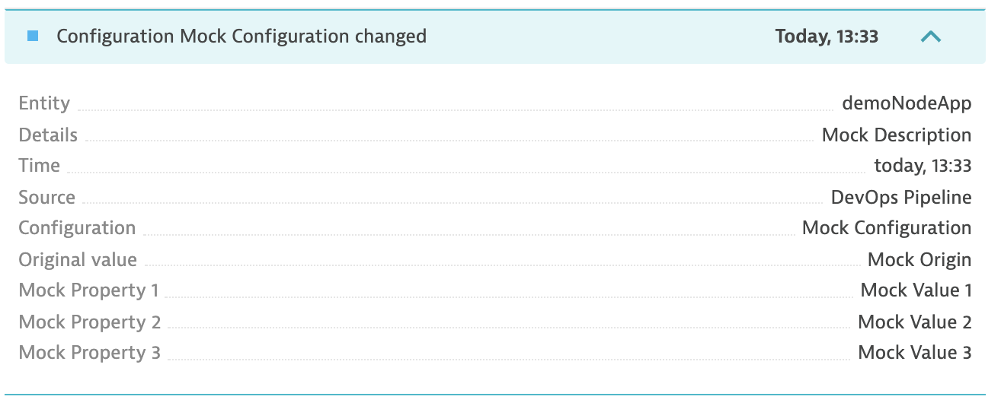
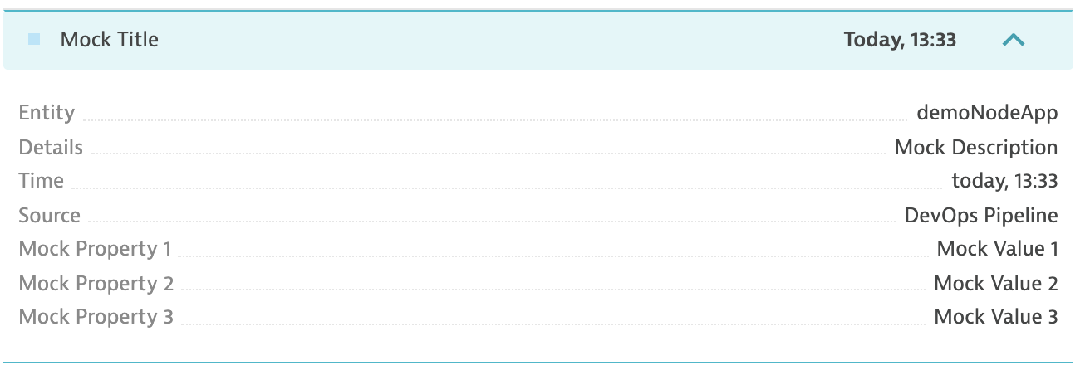
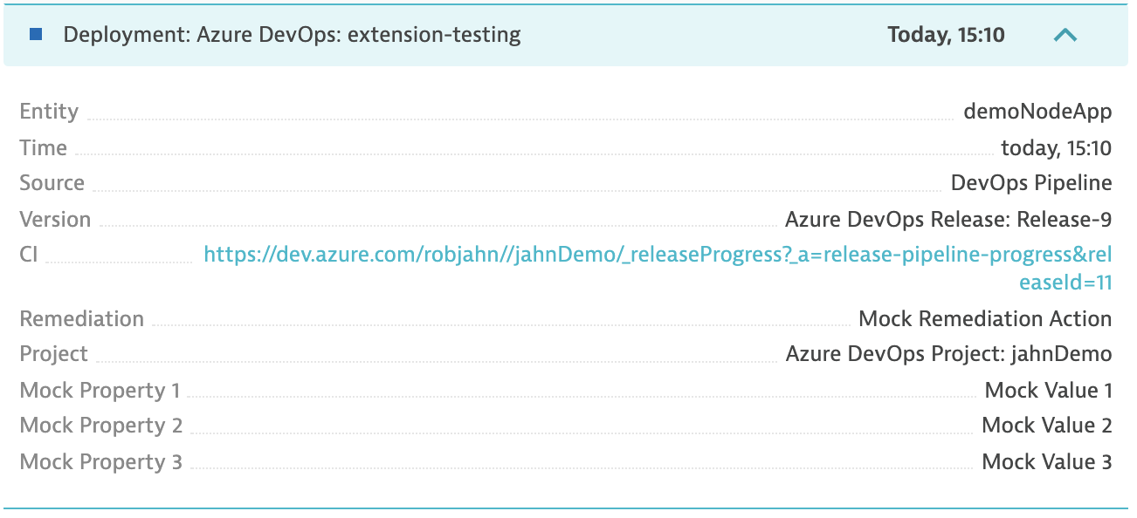

Slide 13
